Slide 1
Dynamic Enhanced Bayesian Network for the risk assessment of coupled High Temperature Electrolysis Facilities and Nuclear Power Plants
Stefano Marchetti, Dario Valcamonico, Francesco Di Maio, Enrico Zio

Slide 2

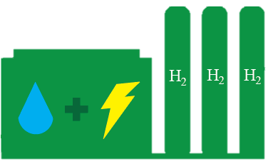
Context of the research
Large scale hydrogen production with High Temperature Electrolysis Facilities (HTEF) coupled with Nuclear Power Plants (NPP)
The licensing of the integrated plants requires assessing the increased risk to the NPP due to the HTEF

Slide 3

Problem statement
Current approach
Limitations
No uncertainty quantification
No imprecision
No Bayesian update as new evidence becomes available
No tool to perform inference

Slide 4
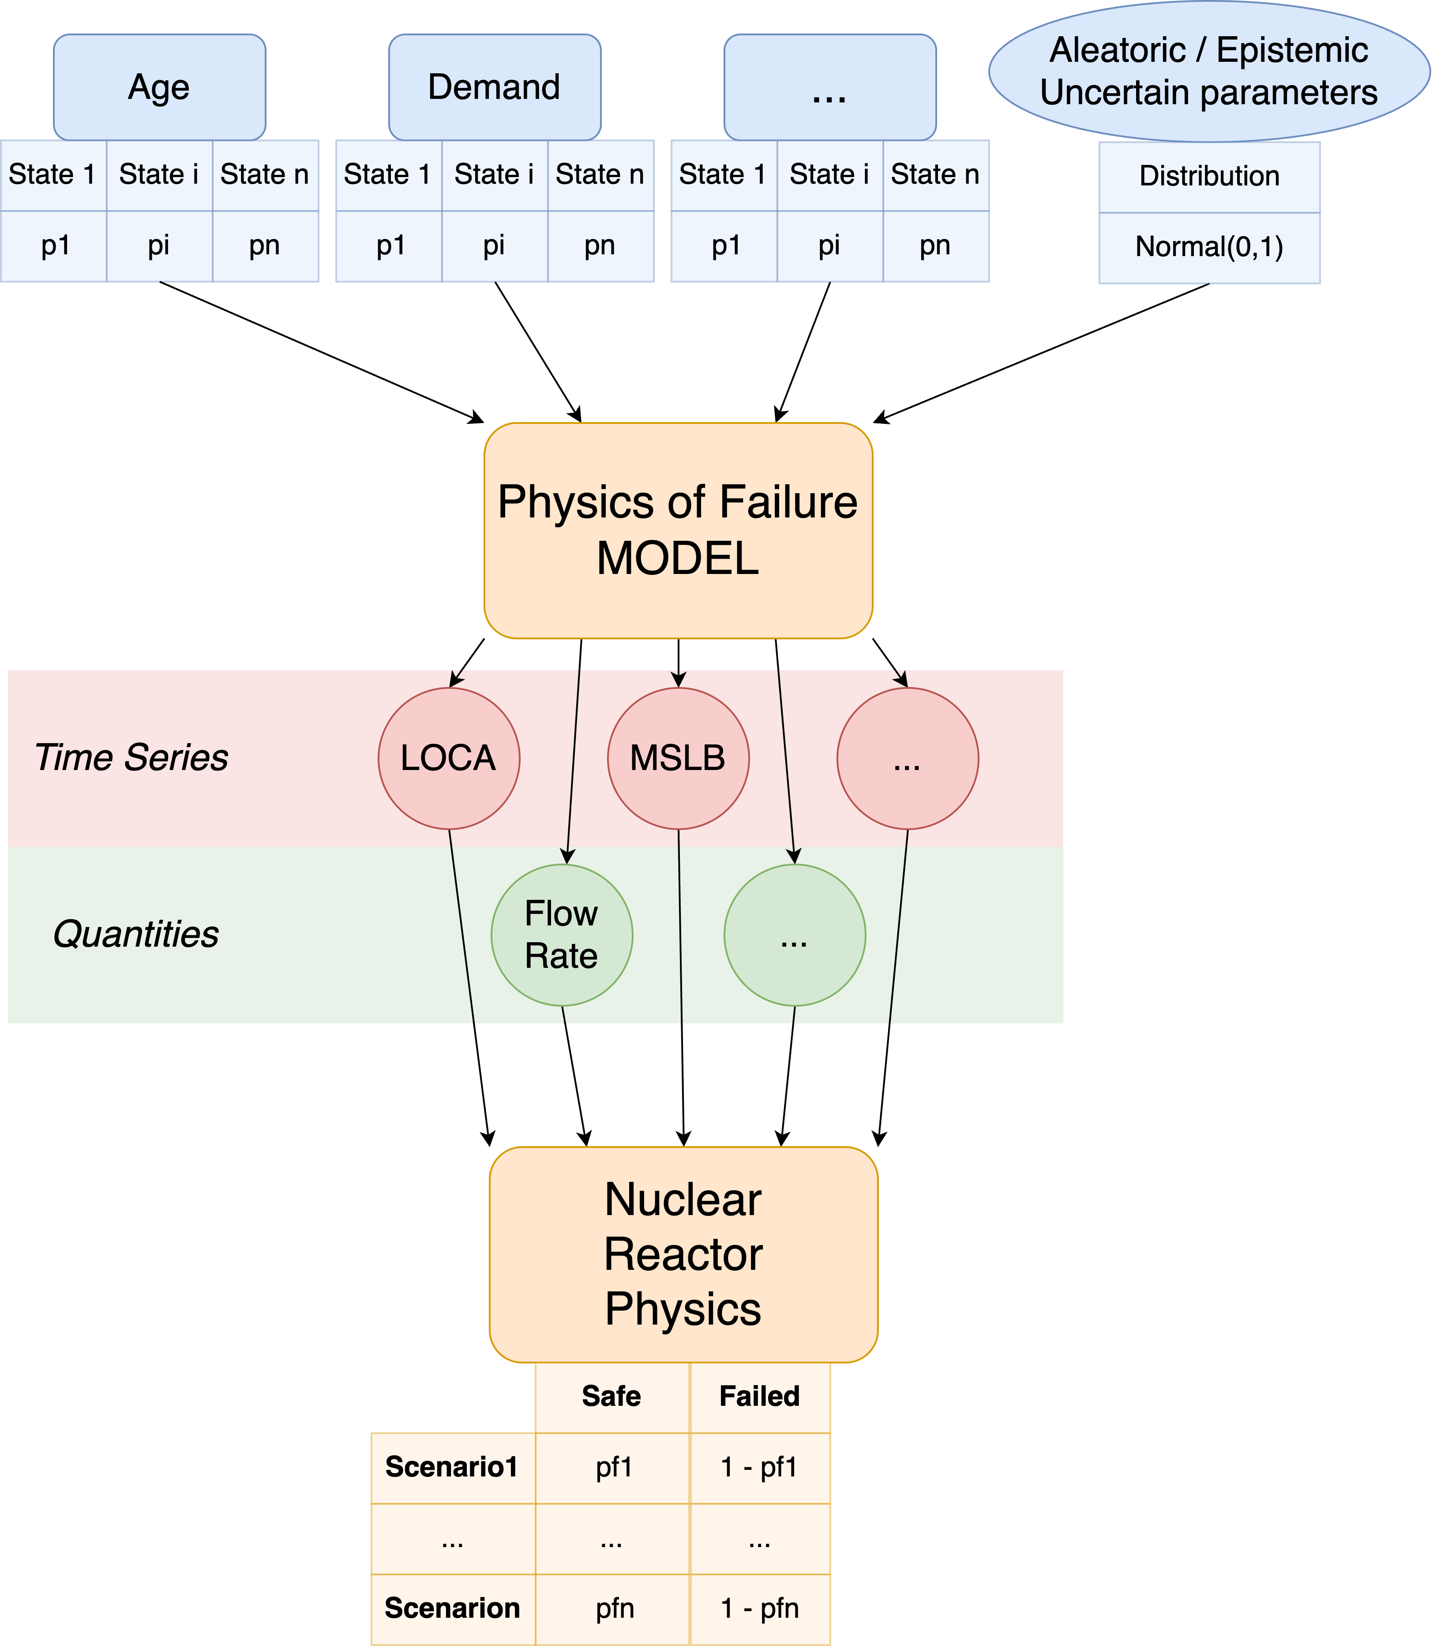
Proposed solution: Enhanced Imprecise Bayesian Network

Slide 5
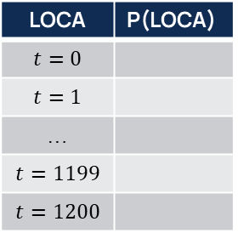
Proposed solution: Enhanced Imprecise Bayesian Network
Added values
Uncertainty quantification
Imprecise CPTs
Inference (forward and backward)
Bayesian update
Issues
Time-dependent variables discretization (too many states!)
LOCA | P(LOCA)
$$t=0$$
$$t=1$$
…
$$t=1199$$
$$t=1200$$
LOCA

Slide 6


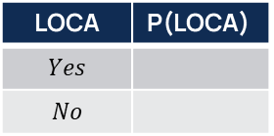
Proposed solution: Dynamic Enhanced Imprecise Bayesian Network
Time = t1
Time = t2
Added values
Uncertainty quantification
Imprecise CPTs
Inference (forward and backward)
Bayesian update
Temporal
link
Inference on temporal nodes (e.g., failure times, physical quantities…)
LOCA
LOCA | P(LOCA)
$$Yes$$
$$No$$
Only two states

Slide 7

Enhanced Bayesian Networks for the risk assessment and management of Oil and Gas plants

Slide 8
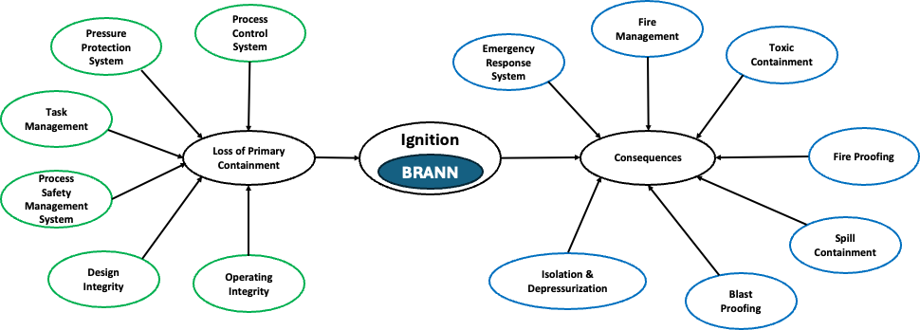
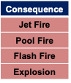
Context of the research
Risk assessment in O&G facilities by Bayesian Network (BN) Modeling
Mitigative safety barriers
Preventive safety barriers

Slide 9
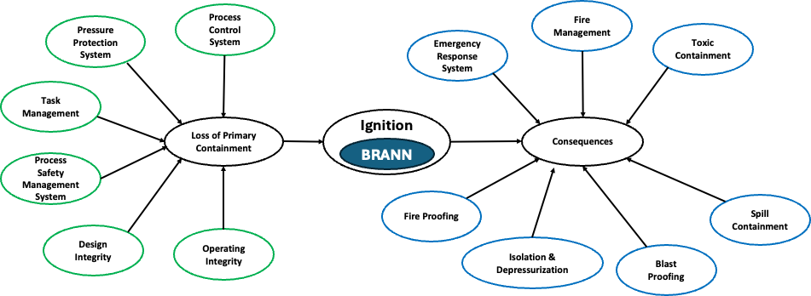
Problem statement
We want to perform backward inference to identify the optimal maintenance schedule and/or design improvements

Slide 10
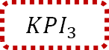

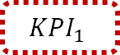
Problem statement
However, the severity assessment and the risk aggregation cannot be included into the BN
$$KPI_{1}$$
$$KPI_{2}$$
Severity assessment
Risk aggregation
$$KPI_{3}$$
However, the elaboration of the KPIs cannot be included into the BN
We want to perform backward inference to identify the optimal maintenance schedule and/or design improvements

Slide 11
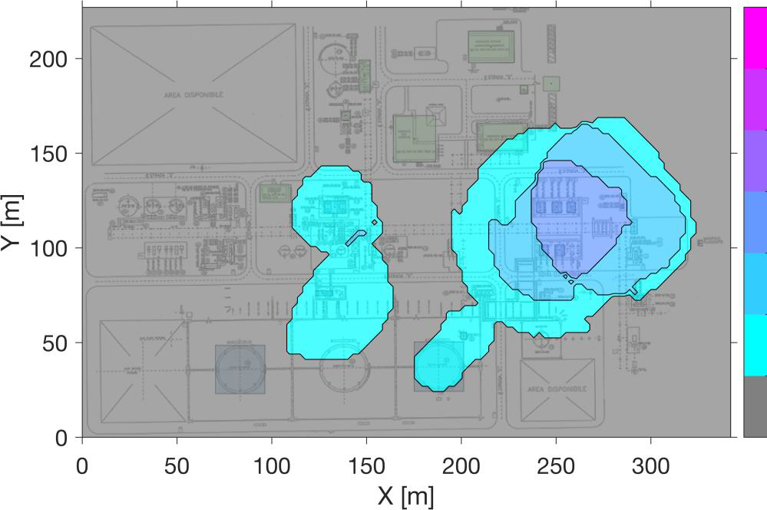
Proposed solution: Enhanced Bayesian Network
Forward and backward inference on the risk and on the KPIs

